Slide 1
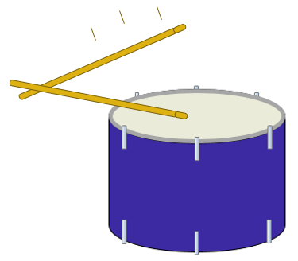
Drum beat
When a drum is hit it makes a sound.

Slide 2
Drum beat
a. What happens when the drum is hit harder?
Which is the best answer?
A
The sound is the same
B
The sound is louder
C
The sound lasts longer

Slide 3
Drum beat
b. Why do you think this will happen? Which is the best answer?
A
It is the same drum
B
It is hit with a bigger force
C
The drum vibrates in the same way
D
The drum vibrates with bigger vibrations

